Slide 1

Data Driven Applications
Web Applications
Data Access – PHP and MySQL
User Interaction
Lecture 3

Slide 2
Learning Outcomes
You will be able to describe and use the following
User Registration
User Password encryption

Slide 3
Setup
Make sure your Apache server is running – check your XAMPP control panel
In your htdocs folder make sure there is a subfolder for this topic
Eg ..C:/xampp/htdocs/K00999999/T02
Download and unzip the code for this lecture to this folder
Restore the database from the project /database folder
Start NETBEANS
Open the netbeans project for this lecture at this location

Slide 4
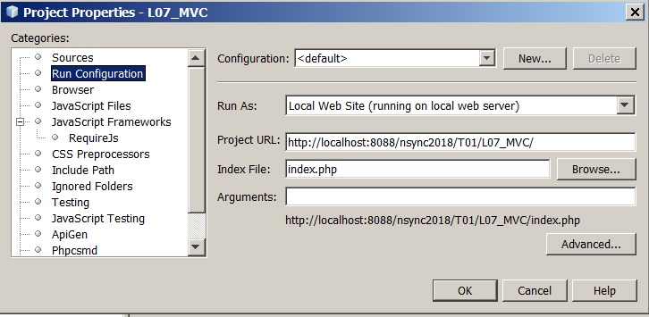
Configure NETBEANS project Properties
Right click on the project, select PROPERTIES/RUN CONFIGURATION
Set the PROJECT URL and index file to the correct one for your setup

Slide 5
Setting up MySQL database
To run these examples you will need a database set up
Restore the database that was provided as part of the PHP project you have just unzipped.
See the DATABASE folder

Slide 6
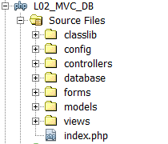
Website structure
The website files are structured as follows:
Style Sheets
Application
Configuration/Globals
Class Library
Database backup
MVC
HTML form
templates

Slide 7
Lecturer User Registration example
To implement the registration process we need
A ‘password’ field added to the Lecturer table in the database
To implement the Registration menu option
A Registration form which validates the users input in each field
Lecturer Class – which maps to the Lecturer table in the database

Slide 8
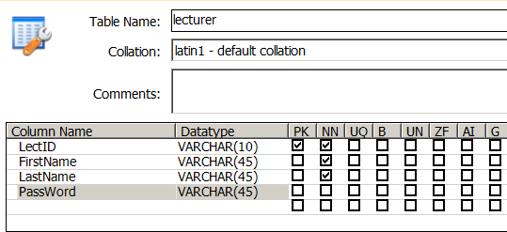
Lecturer table
Lecturer table – password field added

Slide 9
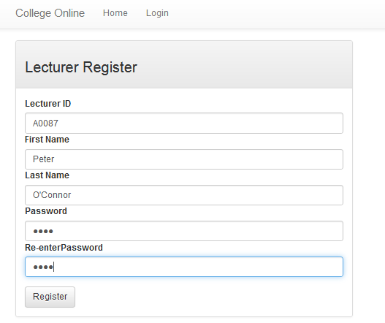
Registration Form
Forms/registerForm.php

Slide 10
Retrieving values from form – escaping strings
When the registration form is submitted its values are passed to the $_POST array and the page ACTION requests the PageID=process_registration
Its important to ESCAPE any special characters that the user has inserted into the form to avoid any possible errors later when creating the SQL statement.
This will permit entering names like O’Connor in the form.
See Lecturer::setStringPanel_1() method which uses the inbuilt MySSQLi::real_escape_string() method
$this->lectID= $this->db->real_escape_string($_POST['lectID']);
$this->lectFirstName= $this->db->real_escape_string($_POST['lectFirstName']);
$this->lectLastName= $this->db->real_escape_string($_POST['lectLastName']);
$lectPass1= $this->db->real_escape_string($_POST['lectPass1']);
$lectPass2= $this->db->real_escape_string($_POST['lectPass2']);

Slide 11
Password Encryption
This example uses one way password encryption (hash md 160) function that is built in to PHP
See Lecturer::registerEncryptPW() method.
$this->password = hash('ripemd160', $this->password);
//create the SQL insert statement for the new record
$sql='INSERT INTO `college`.`lecturer`(`LectID`,`FirstName`,
`LastName`,`PassWord`)VALUES("'.
$this->lectID.'","'.
$this->lectFirstName.'","'.
$this->lectLastName.'","'.
$this->password.'")';

Slide 12
Encryption of the password in the database
A cryptographic hash function is a hash function which is considered practically impossible to invert, that is, to recreate the input data from its hash value alone.
One way encryption – there are dozens of algorithms that may be used – the one used here is ripemd160
Note it may be necessary to increase the size of the password field in the lecturer table as the output of ripemd160 requires 40 characters field width in the database for the password
Use the encryption key to encode the password in the DB
http://php.net/manual/en/function.password-hash.php
http://php.net/manual/en/function.hash.php

Slide 13
view_1_panel.php
At the start of every view we extract the $data associative array into a correspondingly named set of variables for the view. This is tedious.
Instead we can use PHP extract() function:
See PHP Manual: http://php.net/manual/en/function.extract.php
$pageTitle = $data['pageTitle'];
$menuNav = $data['menuNav'];
$stringPanel_1 = $data['stringPanel_1'];
$panelHead_1 = $data['panelHead_1'];
extract($data);

Slide 14
Problem – Form Data Validation
One problem is that a user may enter invalid information in a form eg:
a string ‘abc’ where an integer is expected
Too many characters for example 45 character Lastname where the DB table is specified as VARCHAR(30)
Invalid characters – for example using %* as part of a First/LastName
It is helpful to ensure that data entered into the form is validated at the browser (client) point of entry (ie the browser) rather than submitting to the php script to process and reject.
This is facilitated by utilising the attributes of the <input> elements of the form.
These are processed as the user fills out and submits the form

Slide 15
Form Validation – HTML charset
A METATAG must be added to the VIEW to ensure that an international character set is supported when validating form data (see the <head> section of the VIEW)
The database connection must also support UTF 8 by executing this query SET NAMES 'utf8'. See index.php for this line
UTF-8 supports validation of characters such as áéíóú etc
This will allow names such as Ciarán to be passed from the browser through the form to $_POST and to be saved correctly in the database
<meta charset="utf-8">
@$db->query("SET NAMES 'utf8'");

Slide 16
Form validation - <input> attributes
‘required’ - specifies that an input field must be filled out before submitting the form.
‘type’ - specifies the type of <input> element to display.
‘id’ - specifies a unique id for an HTML element
‘name’ - is used to reference elements in a JavaScript, or to reference form data after a form is submitted eg in $_POST superglobal.
‘pattern’ - specifies a regular expression (REGEX) that the <input> element's value is checked against.
‘title’ - Specifies extra information about an element (displayed as a tool tip)

Slide 17
Form validation using REGEX
HTML forms support a ‘pattern’ attribute which specifies a regular expression (REGEX) that the <input> element's value is checked against.
Note this example of a REGEX validation pattern:
A REGEX pattern can be defined for each input field in the form see - http://www.rexegg.com/regex-quickstart.html
See the following for more on form validation and validation patterns
http://www.w3schools.com/html/html_form_attributes.asp
http://www.w3schools.com/jsref/jsref_obj_regexp.asp
pattern="[a-zA-Z0-9óáéí']{1,48}"

Slide 18
REGEX can be used to analyse a STRING
This REGEX rule requires the password string to match the following rules:
Must not contain linebreak character
Must contain at least one digit 0-9
Must contain at least one lowercase a-z
Must contain at least one uppercase A-Z
Must be at least 8 characters
(….)
Patterns to be matched by string
(?=.*\d)(?=.*[a-z])(?=.*[A-Z]).{8,}
\d
One digit 0-9
{8,}
8 or more characters
.*
Any character except linebreak
?=
Positive lookahead
ie Anywhere in string ahead
[a-z]
One character in range
[A-Z]
One character in range

